Slide 1
Enterprise Computing Using Java EE
Unit –I
Fundamentals Object Oriented Concepts
1

Slide 2
Enterprise Computing Using Java EE
Contents:
Programming Paradigms (Procedure Oriented and Object Oriented)
Object Oriented Programming concepts
Structure of Java program
Creating an application in Java
Compiling and executing applications in java

Slide 3
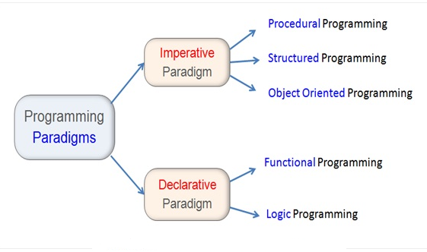
Enterprise Computing Using Java EE
Programming Paradigms:
A model that serves as a school of thoughts for programming of computers. It is the style or way of thinking about and approaching problems.
Programming paradigms are a way to classify programming language based on their features.

Slide 4
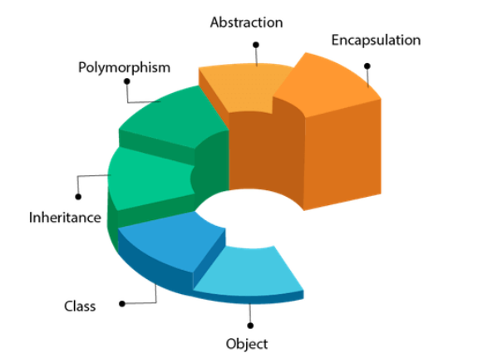
Object Oriented Programming Concept:
Object Oriented programming is a programming style that is associated with the concept of Class, Objects and various other concepts revolving around these two, like Inheritance, Polymorphism, Abstraction, Encapsulation etc.

Slide 5
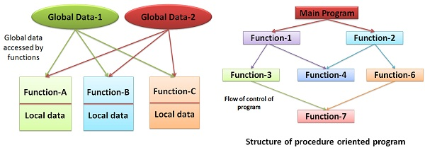
Procedure Oriented Programming Concept:
Procedure oriented programming is a set of functions. It focuses on function rather than data.

Slide 6
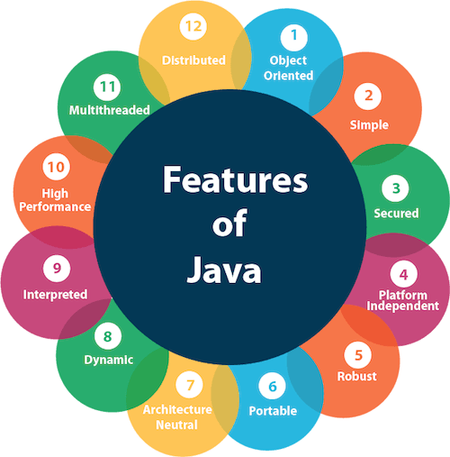
Introduction to Java Programming Language
Features of Java:
The primary objective of Java programming language creation was to make it portable, simple and secure programming language.

Slide 7
Introduction to Java Programming Language
Features of Java:
1. Object Oriented: Java is an object-oriented programming language. Everything in Java is an object. Object-oriented means a combination of different types of objects that incorporates both data and behavior. Basic concepts of OOPs are:
1. Class: Class is a logical structure which contains logic.
2. Object: Object is a physical entity which has state and behavior, which we can touch, see and feel.
3. Inheritance :It is the process of creating the new classes while using the behavior of the existing classes
by extending some new features which provides reusability.
  4. Polymorphism: Single Interface with multiple Methods.
5. Abstraction: Talking about those things which are relevant to particular domain, while hiding the
background details. Hiding internal implementation from user and just highlighting the set of services
what we are offering is called as abstraction.
6. Data Hiding: The process of hiding the internal information of user so that outside person can not
access out data directly.
7. Encapsulation: The process of encapsulating variables and corresponding methods into a single
components is known as encapsulation.

Slide 8
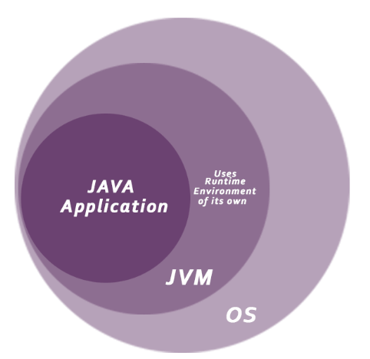
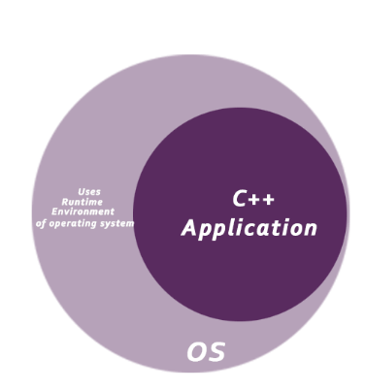
Introduction to Java Programming Language
Features of Java:
2. Simple: Java is very easy to learn, and its syntax is simple, clean and easy to understand. Programs are easy to write and debug because java does not use the pointers explicitly.
3. Secured: Every program executes under the full control of JVM. JVM acts as firewall between local environment and foreign environment. Hence the local environment is secured automatically.

Slide 9
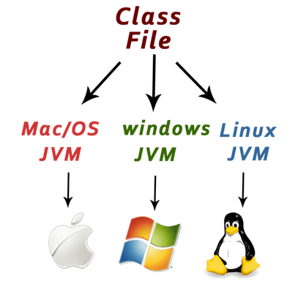
Introduction to Java Programming Language
Features of Java:
  4. Platform Independent: The .java file is converted into .class file after compilation .This byte code can be run on different platforms i.e., Write Once and Run Anywhere(WORA) .But we need different JVM for each platform. This creation of JVM is quite simple and easy.
  5. Robust: Java is strongly typed language; as it checks the code at compile time as well as also at runtime time, results in less runtime errors and logical errors. Java has strong memory allocation and automatic garbage collection mechanism. It provides the powerful exception handling and type checking mechanism as compare to other programming languages. There is lack of pointers that avoids security problems. All
these features makes java more robust.

Slide 10
Introduction to Java Programming Language
Features of Java:
  6. Portable : Java is portable because it facilitates us to carry the Java byte code to any platform. It doesn't require any implementation. The Java interpreter can execute Java byte code directly on any machine to which the interpreter has been ported.
7. Dynamic : Java is a dynamic language. It supports dynamic loading of classes. It means classes are loaded on demand. It also supports functions from its native languages, i.e., C and C++. Java supports dynamic compilation and automatic memory management (garbage collection).
  8. Architectural Neutral: Java is not tied to any specific machine or operating system architecture. Java is machine independent i.e. independent of hardware. Java is architecture neutral because there are no implementation dependent features, for example, the size of primitive types is fixed.
In C programming, int data type occupies 2 bytes of memory for 32-bit architecture and 4 bytes of memory for 64-bit architecture. However, it occupies 4 bytes of memory for both 32 and 64-bit architectures in Java.

Slide 11
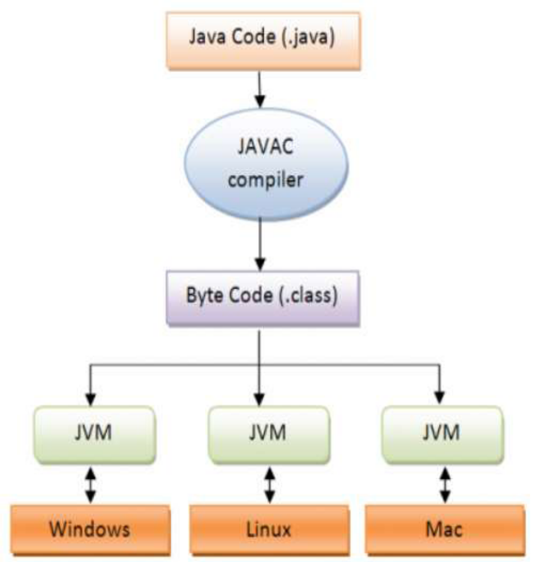
Introduction to Java Programming Language
Architectural Neutral:

Slide 12
Introduction to Java Programming Language
Features of Java:
9. Interpreted: Java is interpreted language because it checks the code at compile time and runtime as JIT(Just-In-Time) compiler is present in JVM and is responsible for compilation and execution.
  10. High performance :Java provides JIT(Just-in-time) Compiler a component of JRE inside JVM which converts java code to .exe during runtime. Which makes java faster than any language and enables high performance.
11. Multithreaded: In multithreaded programming process is divided into different threads. A thread represents an individual path of execution. By such division we can save the wastage of CPU time in a process. Multithreading means a single program having different threads executing independently at the same time. Multiple threads execute instructions according to the program code in a process or a program.
Multitasking:
    Process Based
    Thread Based

Slide 13
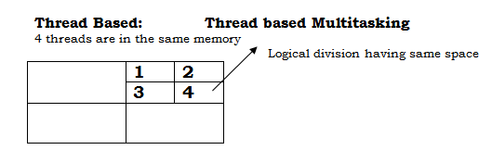
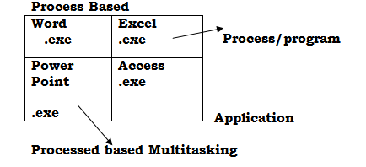
Introduction to Java Programming Language
Features of Java:
Thread is a power that takes the CPU time to perform the delegated work.
  12. Distributed: Java is distributed because it facilitates users to create distributed applications in Java. RMI and EJB are used for creating distributed applications. This feature of Java makes us able to access files by calling the methods from any machine on the internet.

Slide 14
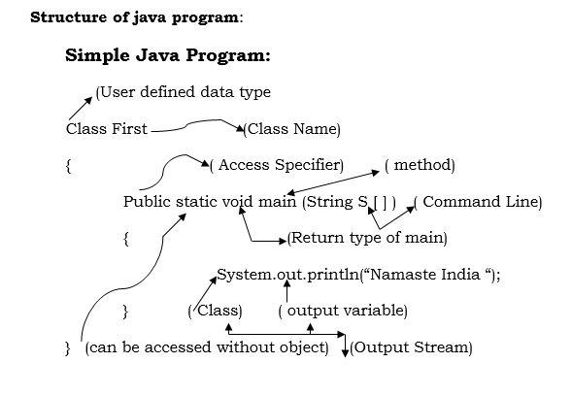
Introduction to Java Programming Language
Structure of Java program

Slide 15
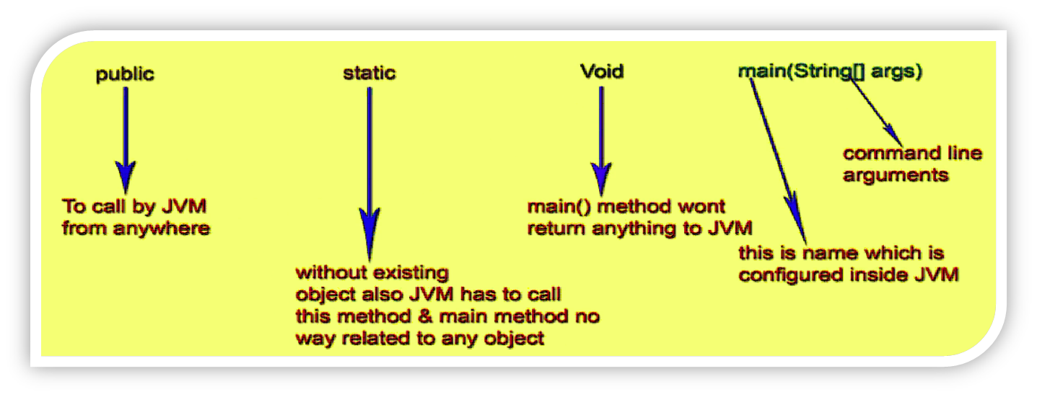
Introduction to Java Programming Language
Structure of Java program

Slide 16
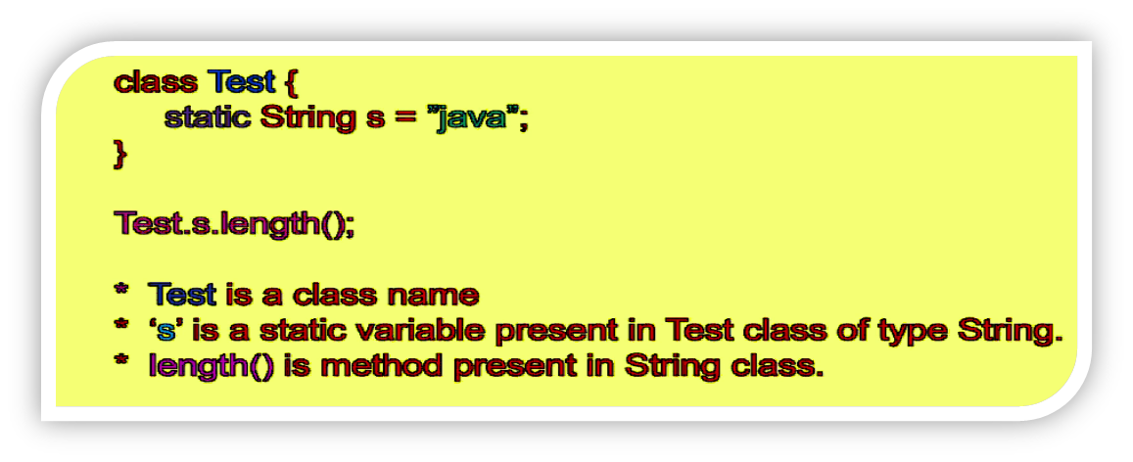
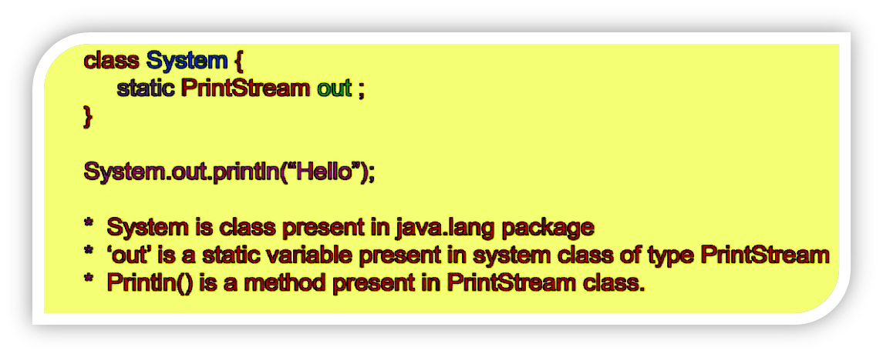
Introduction to Java Programming Language
Structure of Java program: System.out.println();

Slide 17
Introduction to Java Programming Language
Compiling and executing applications in java
File is the compilation unit in java. During compilation of java program as many as .class file will be created as number of classes present.
main( ) method is static and is called by Java interpreter before any object are made.
All java application begin execution by calling main() . Java main( ) method has no return type.
System is a class that provides access to the system, all the methods are the members of System class and out is the output stream that is connected to the console.
main() method can also be overloaded like other method.
main() method can not be overridden like other methods in java.

Slide 18
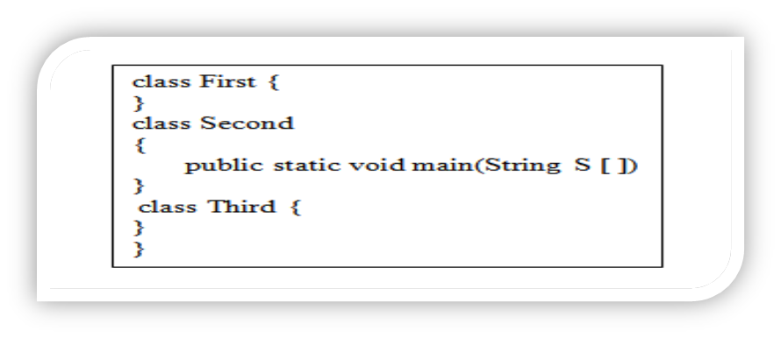
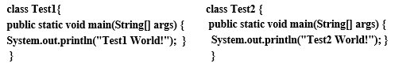

Introduction to Java Programming Language
Compiling and executing applications in java
Note: Three .class file will be created but execution will done through class second because it contains main( ) method.
The class contains main method is called Main class and java allows to declare multiple main class in a single source file.
Source File Structure:

Slide 19
Introduction to Java Programming Language:
JVM (Java Virtual Machine):
Runtime system for Java
It accepts byte code line by line and executes it, hence it is known as interpreter for java. Hence Java is compile as well as interpreted language which makes java more secure.
JVM is interpreter for byte code.
Role of JVM:
A) Loading of class files.
B) Verification of class files i.e. Class files should contain valid byte code.
C) Interpretation of byte code and then run the program.
Byte code:
Byte code is highly optimized set of instruction designed to be executed by JVM.

Slide 20
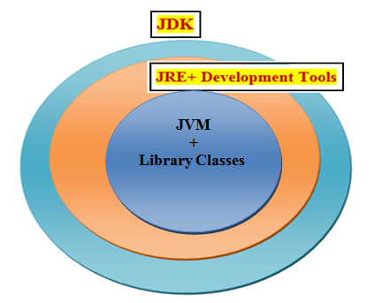
Introduction to Java Programming Language
Types of Java Programs:
Application: Standalone programs.
Applets: Delivered over WWW to clients(browser)
Servlets: Runs on WWW Server.
JDK Environment & Tools:
JDK: (Java Development Kit):--- JDK provides an environment to
develop and run java applications.
JRE:(Java Runtime Environment):-- JRE provides an environment just
to only run java application. Who runs the java application inside JRE? i.e JVM.
JVM:(Java Virtual machine):--JVM is Interpreter which is responsible to run the java program
line by line.
JDK: JRE+ Development Tools
JRE: JVM+ Library Classes

